Slide 1

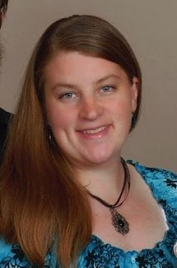
Linda Johnson
Fall 2021 Tech-Moms Experience

Slide 2
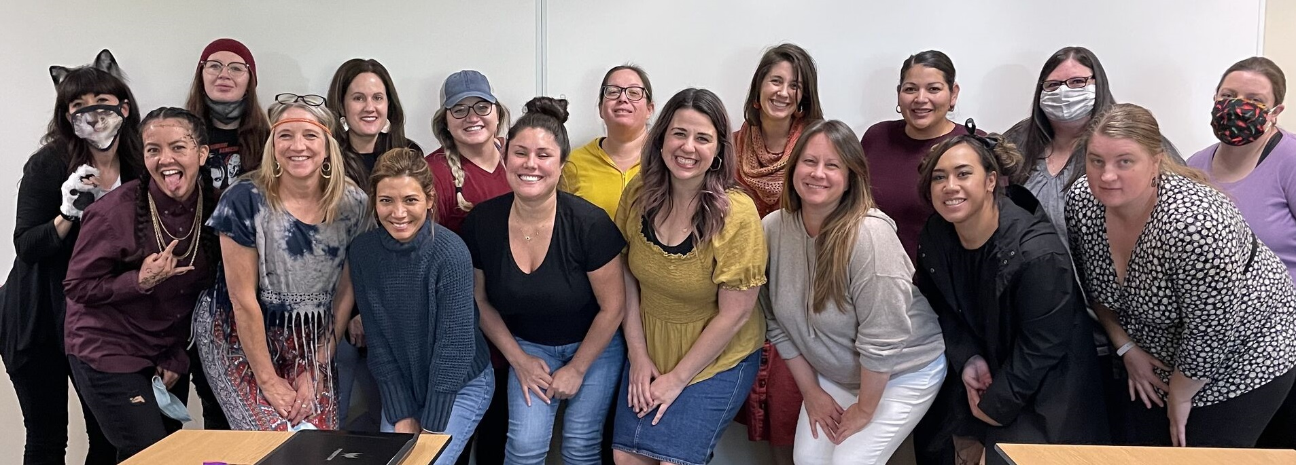


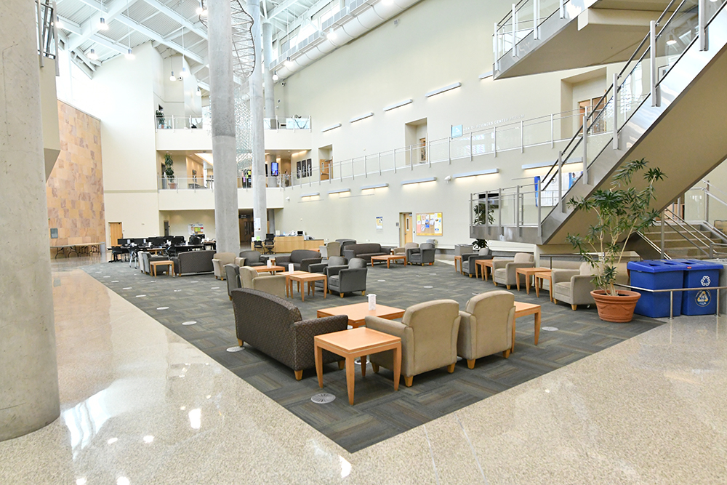


Back to School
Empowering Life Long Learning

Slide 3
<script src="https://platform.linkedin.com/badges/js/profile.js" async defer type="text/javascript"></script><div class="badge-base LI-profile-badge" data-locale="en_US" data-size="medium" data-theme="light" data-type="VERTICAL" data-vanity="linda-johnson-422b54103" data-version="v1"><a class="badge-base__link LI-simple-link" href="https://www.linkedin.com/in/linda-johnson-422b54103?trk=profile-badge">Linda Johnson</a></div>

Slide 4
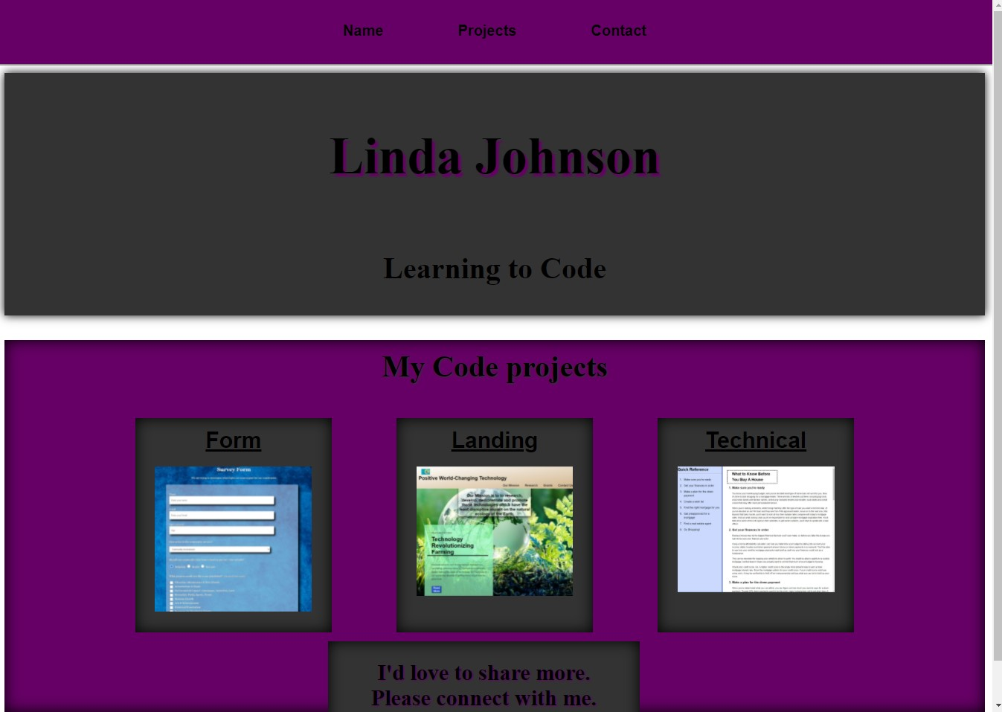
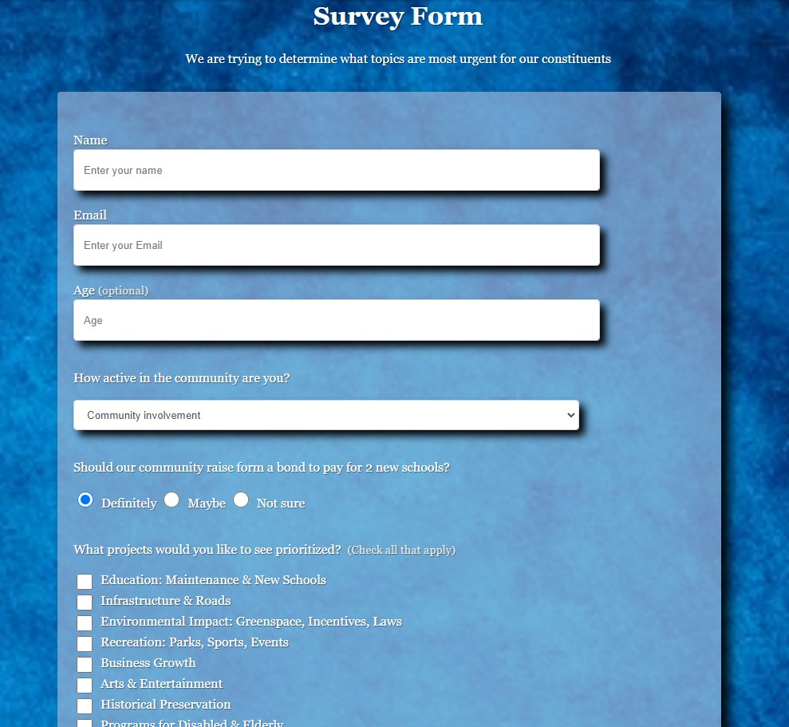
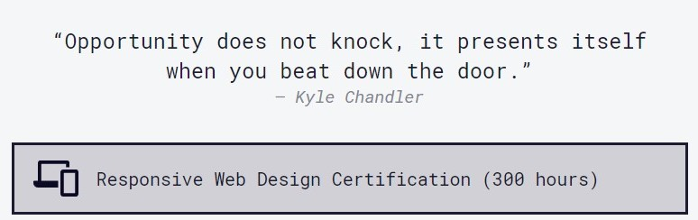
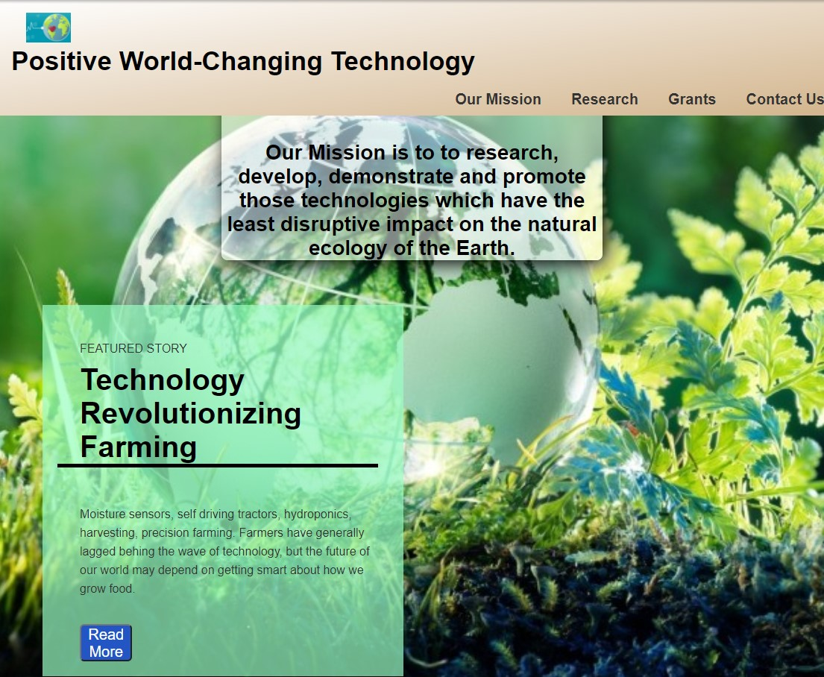

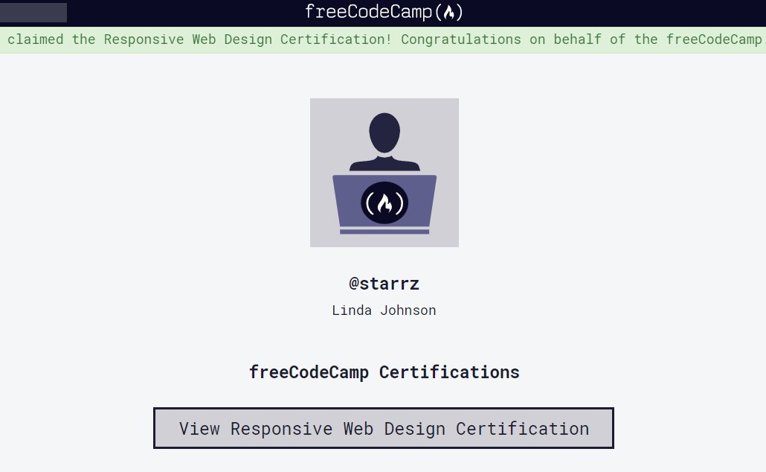
FreeCodeCamp.org
List of awesome stuff learned
List of awesome stuff learned
List of awesome stuff learned
List of awesome stuff learned
List of awesome stuff learned
List of awesome stuff learned
List of awesome stuff learned
List of awesome stuff learned

Slide 5
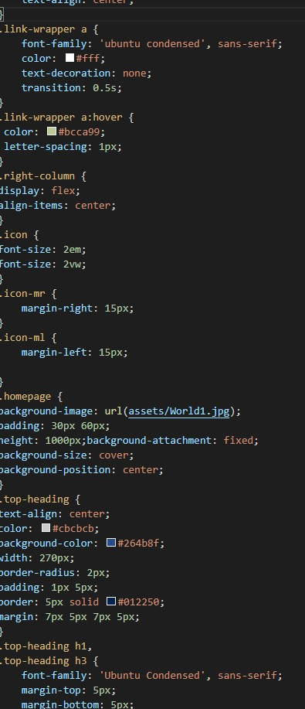
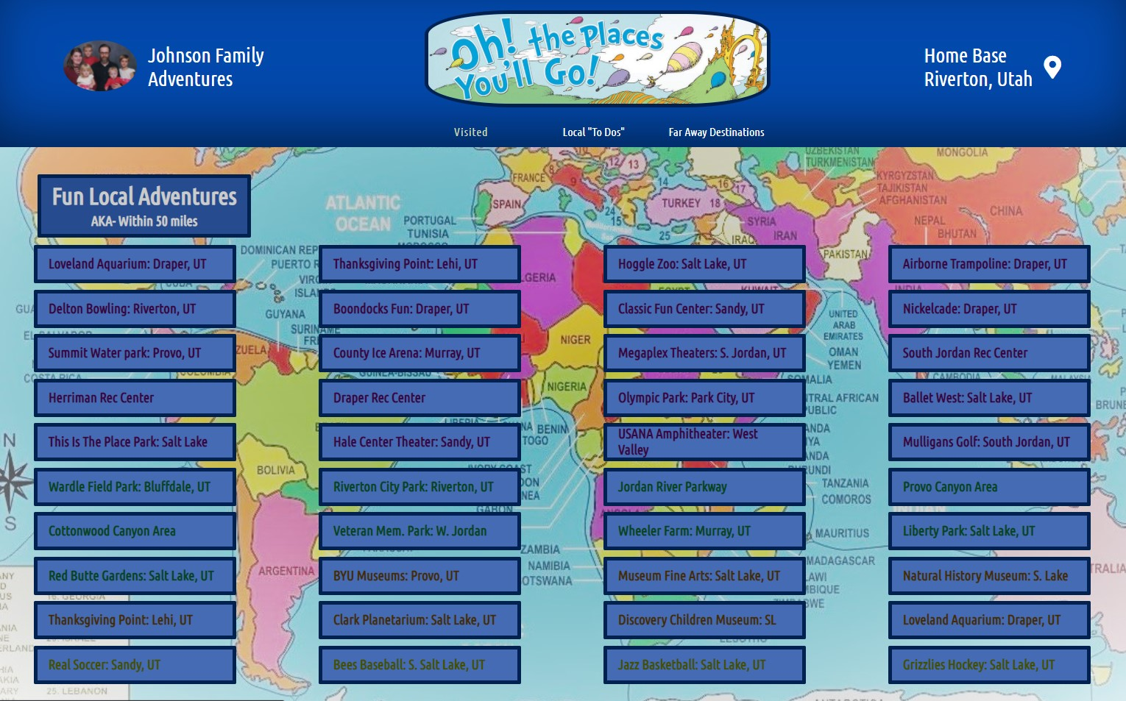
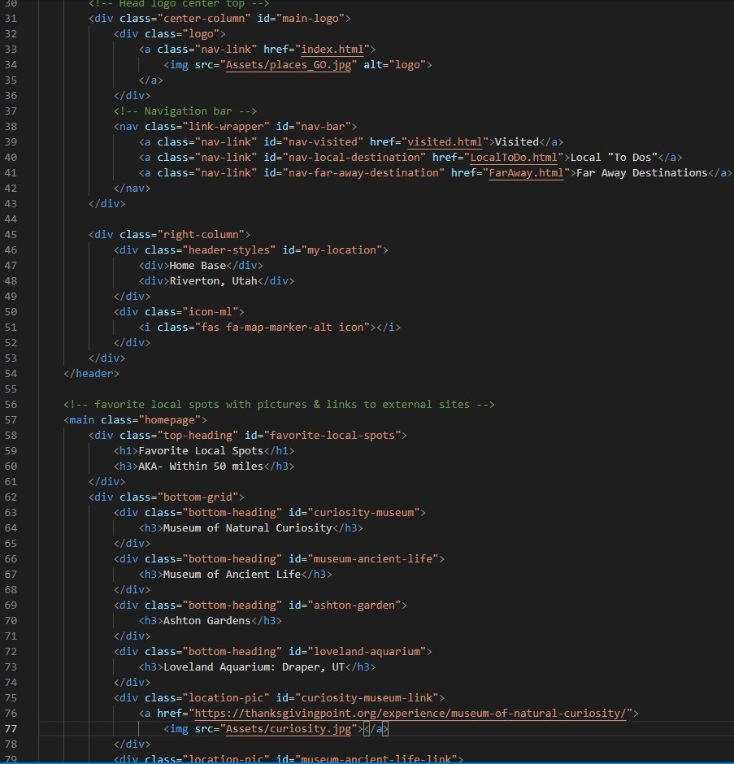
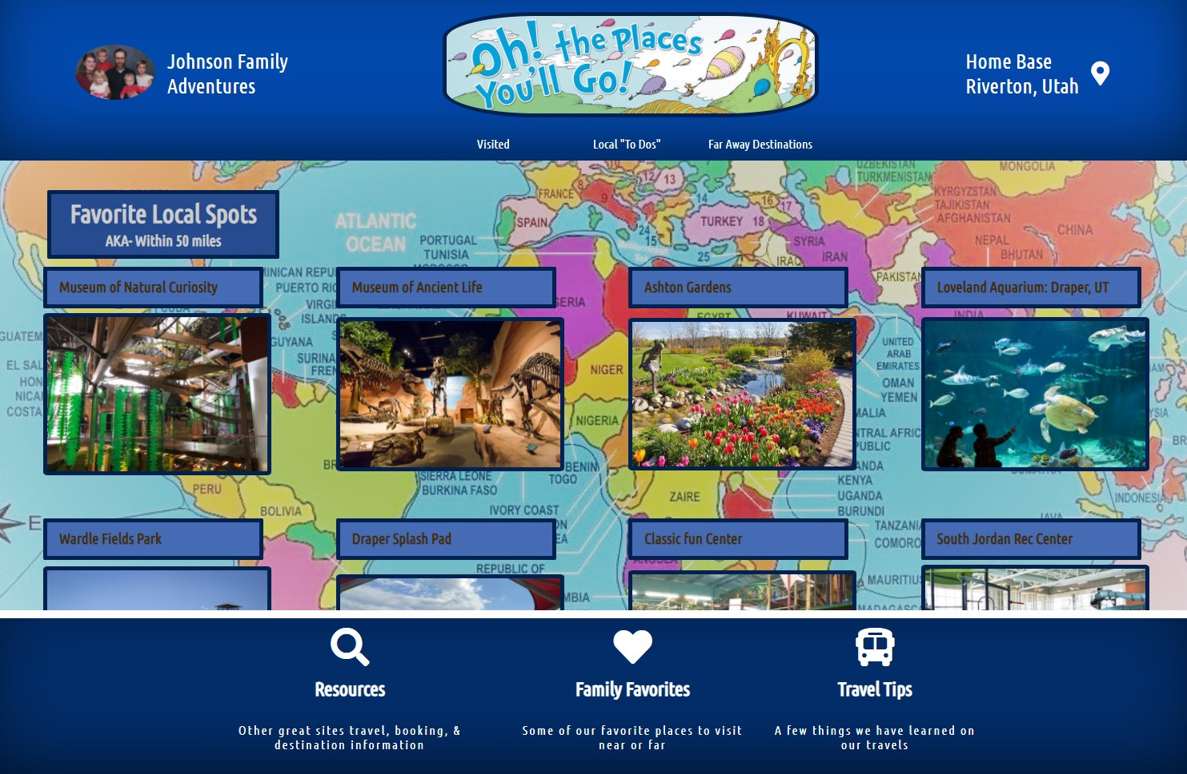
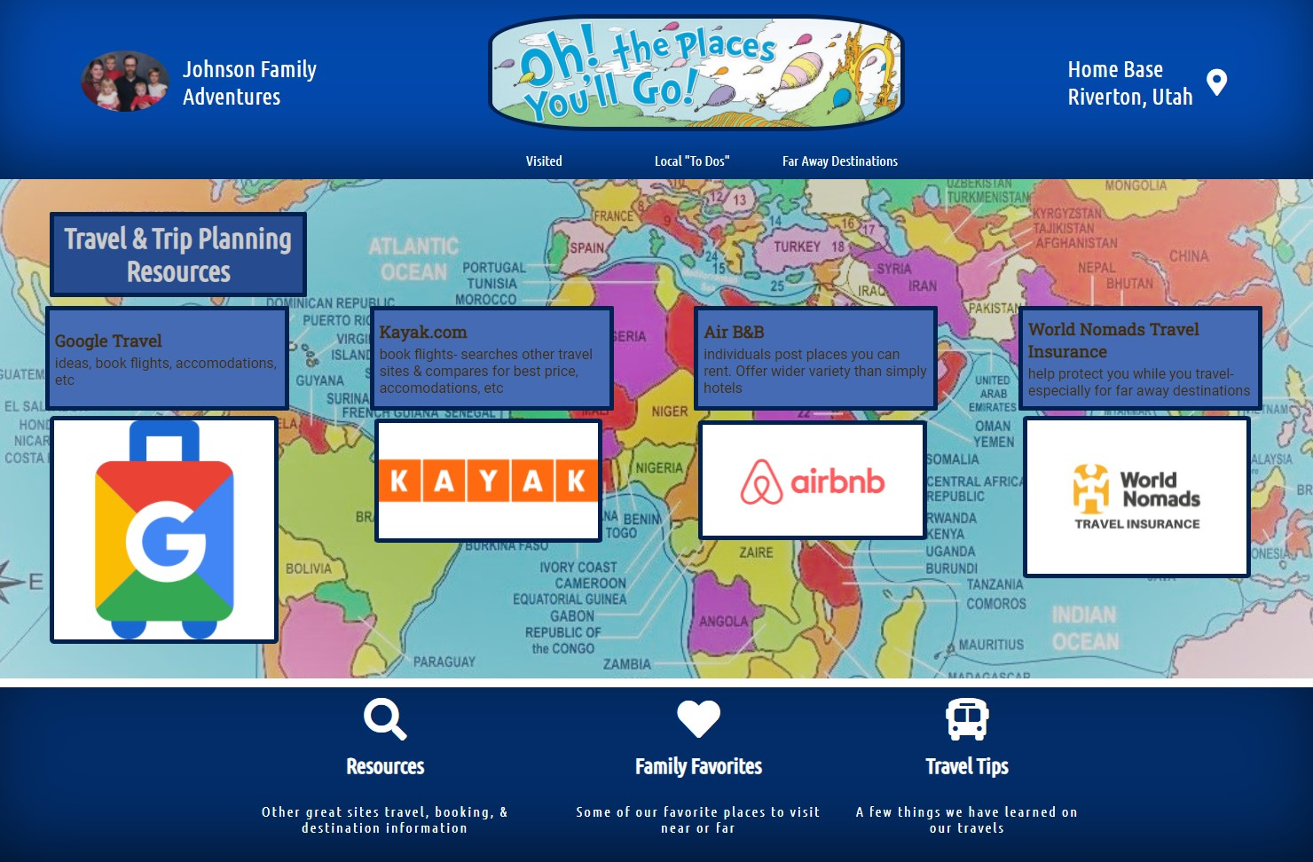
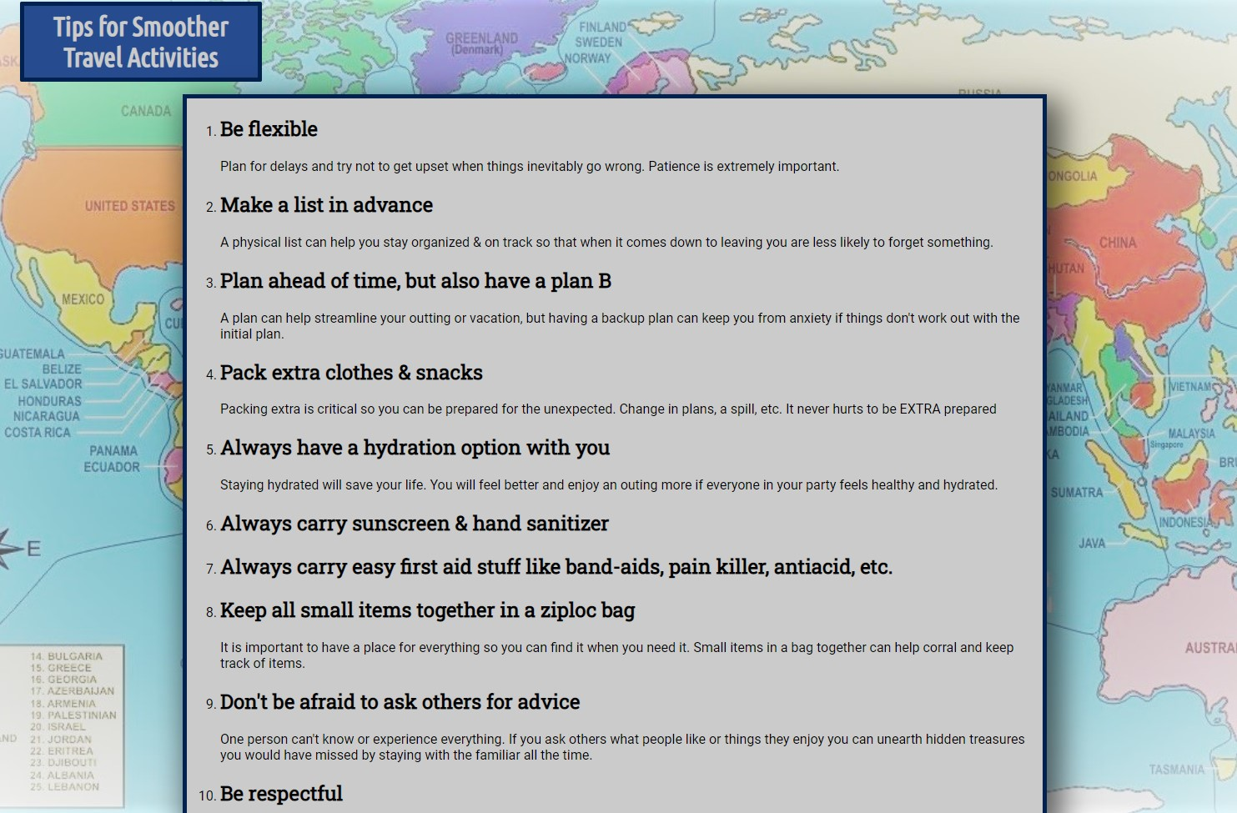
Family Travels Project
Cool stuff to talk about here

Slide 6
What did you learn that will have the biggest impact on you?
Tech Moms helped take some of the mystery out of tech.
It is an attainable field
I am capable of doing any job I set my mind to.
So much variety in the phrase “working in tech.” There are so many possibilities and the course does an amazing job providing an understanding of tech jargon, company structure & flow, and broadening my understanding of tech from the 1940’s on up

Slide 7

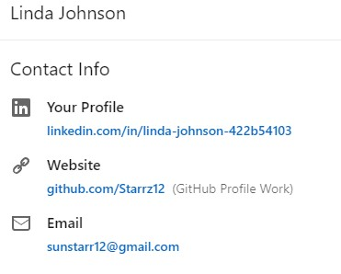
Plans for the future
Enrolled in javascript course at slcc
Continuing to get as many free certifications online as I can
I would love to get a paid internship in a large company or an entry level position in a smaller startup/mid-size.
with each presenter who has shared her field of expertise I’ve thought “That’s pretty neat. I could do that.”

